Slide 1
HLC Comprehensive Reaccreditation:
Open Forum for Criteria 3 and 4
Neil Pagano, Associate Provost for Accreditation and Assessment
Tyler Roeger, Project Manager for Assessment, Accreditation, and Faculty Development Initiatives
May 16 & 17, 2018

Slide 2
Accreditation
Higher Learning Commission (HLC)
Pathways: Open vs. Standard
Site Visit from Visiting Team of Peer Reviewers
Visit: November 5 and 6, 2018
Assurance Argument and Evidence Files

Slide 3
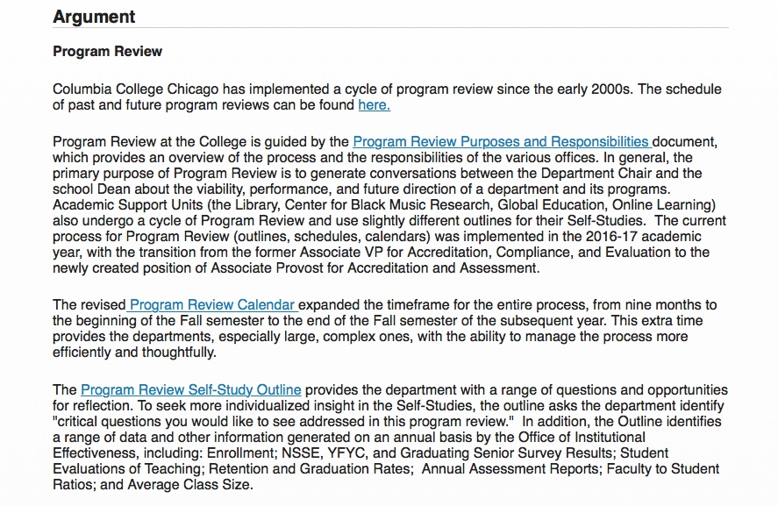

Slide 4
Five Criteria for Accreditation
Mission
Integrity
Teaching and Learning: Resources and Support
Teaching and Learning: Evaluation and Improvement
Resources, Planning, and Institutional Effectiveness

Slide 5
Core Component 3A: The institution’s degree programs are appropriate to higher education.
  Courses and programs are current and require levels of performance by students appropriate to the degree or certificate awarded.
  The institution articulates and differentiates learning goals for undergraduate, graduate, post-baccalaureate, post-graduate, and certificate programs.
  The institution’s program quality and learning goals are consistent across all modes of delivery and all locations (on the main campus, at additional locations, by distance delivery, as dual credit, through contractual or consortial arrangements, or any other modality).
  Evidence:
  List of Majors and Minors
  Program Learning Outcomes for Majors
  Course Learning Outcomes on Syllabi
  Curriculum Policy Manual
  College’s Strategic Plan

Slide 6
Core Component 3B: The institution demonstrates that the exercise of intellectual inquiry and the acquisition, application, and integration of broad learning and skills are integral to its educational programs.
  The general education program is appropriate to the mission, educational offerings, and degree levels of the institution.
  The institution articulates the purposes, content, and intended learning outcomes of its undergraduate general education requirements. The program of general education is grounded in a philosophy or framework developed by the institution or adopted from an established framework. It imparts broad knowledge and intellectual concepts to students and develops skills and attitudes that the institution believes every college-educated person should possess.
  Evidence:
  LAS Core/Columbia Core Curriculum Requirements and Outcomes
  Specific Core Classes: “Big Chicago,” Global Awareness and US Pluralism courses
  Columbia Core: “Creative World,” “Communication, Business, and Technology,” and DEI categories

Slide 7
Core Component 3B (cont.): The institution demonstrates that the exercise of intellectual inquiry and the acquisition, application, and integration of broad learning and skills are integral to its educational programs.
  Evidence:
  Program Learning Outcomes
  Departmental Events: Lectures, Performances, Exhibitions
  Independent Projects and Directed Studies
  Faculty-led Opportunities (Study Abroad)
  Strategic Plan: Goal 2 - 21st Century Curriculum
  Strategic Plan: Goal 3 – Engaging Difference
  Every degree program offered by the institution engages students in collecting, analyzing, and communicating information; in mastering modes of inquiry or creative work; and in developing skills adaptable to changing environments.
  The education offered by the institution recognizes the human and cultural diversity of the world in which students live and work.
  The faculty and students contribute to scholarship, creative work, and the discovery of knowledge to the extent appropriate to their programs and the institution’s mission.

Slide 8
Core Component 3C: The institution has the faculty and staff needed for effective, high-quality programs and student services.
The institution has sufficient numbers and continuity of faculty members to carry out both the classroom and the non-classroom roles of faculty, including oversight of the curriculum and expectations for student performance; establishment of academic credentials for instructional staff; involvement in assessment of student learning.
All instructors are appropriately qualified, including those in dual credit, contractual, and consortial programs.
Evidence:
Faculty to Student Ratios
Curriculum Policy Manual
Faculty Credentials Review

Slide 9
Key metrics of student characteristics and classroom experience:
2003 to 2017
New Fresh HS GPA and ACT
 | 2003 | 2004 | 2005 | 2006 | 2007 | 2008 | 2009 | 2010 | 2011 | 2012 | 2013 | 2014 | 2015 | 2016 | 2017
GPA | 2.77 | 2.79 | 2.85 | 2.88 | 2.90 | 2.96 | 2.92 | 2.97 | 2.99 | 3.04 | 3.16 | 3.20 | 3.25 | 3.27 | 3.37
ACT | 20.3 | 20.5 | 21.1 | 21.6 | 21.3 | 21.4 | 21.4 | 21.6 | 21.6 | 21.8 | 22.2 | 22.7 | 22.9 | 22.7 | 23.2
Total College Minority Enrollment
2003 | 2004 | 2005 | 2006 | 2007 | 2008 | 2009 | 2010 | 2011 | 2012 | 2013 | 2014 | 2015 | 2016 | 2017
31% | 30% | 28% | 27% | 27% | 28% | 30% | 29% | 36% | 36% | 34% | 34% | 35% | 35% | 35%
Student to Full-time Faculty Ratio
2003 | 2004 | 2005 | 2006 | 2007 | 2008 | 2009 | 2010 | 2011 | 2012 | 2013 | 2014 | 2015 | 2016 | 2017
36:1 | 35:1 | 35:1 | 35:1 | 37:1 | 36:1 | 34:1 | 35:1 | 31:1 | 28:1 | 27:1 | 25:1 | 27:1 | 26:1 | 27:1
Student to FTE Faculty Ratio
2003 | 2004 | 2005 | 2006 | 2007 | 2008 | 2009 | 2010 | 2011 | 2012 | 2013 | 2014 | 2015 | 2016 | 2017
14:1 | 13:1 | 12:1 | 13:1 | 12:01 | 12:1 | 12:1 | 12:1 | 9:1 | 11:1 | 11:1 | 11:1 | 12:1 | 12:1 | 12:1
Average Undergraduate Class Size
2003 | 2004 | 2005 | 2006 | 2007 | 2008 | 2009 | 2010 | 2011 | 2012 | 2013 | 2014 | 2015 | 2016 | 2017
16.68 | 17.24 | 17.51 | 17.42 | 17.48 | 17.30 | 16.48 | 16.82 | 16.62 | 16.18 | 16.43 | 16.76 | 18.33 | 17.74 | 17.94

Slide 10
Core Component 3C (cont.): The institution has the faculty and staff needed for effective, high-quality programs and student services.
Instructors are evaluated regularly in accordance with established institutional policies and procedures.
The institution has processes and resources for assuring that instructors are current in their disciplines and adept in their teaching roles; it supports their professional development.
Evidence:
Faculty Evaluation Policies (Faculty Handbook, PFAC Contract)
Faculty Development and Support

Slide 11
Core Component 3C (cont.): The institution has the faculty and staff needed for effective, high-quality programs and student services.
Instructors are accessible for student inquiry.
Staff members providing student support services, such as tutoring, financial aid advising, academic advising, and co-curricular activities, are appropriately qualified, trained, and supported in their professional development.
Evidence:
Syllabus Template (faculty hours requirement)
Student Support: College Advising Center
Learning Studio; Library; Student Financial Services
Staff Qualifications and Development

Slide 12
Core Component 3D: The institution provides support for student learning and effective teaching.
The institution provides student support services suited to the needs of its student populations.
The institution provides for learning support and preparatory instruction to address the academic needs of its students. It has a process for directing entering students to courses and programs for which the students are adequately prepared.
The institution provides academic advising suited to its programs and the needs of its students.
Evidence:
Learning Studio
Library
English and Math Placement
English and Math Developmental Courses
New Student Orientation
College Advising Center (CAC)
CAC Tools: SSC, APR, EASE

Slide 13
Core Component 3D: The institution provides support for student learning and effective teaching.
The institution provides to students and instructors the infrastructure and resources necessary to support effective teaching and learning (technological infrastructure, scientific laboratories, libraries, performance spaces, clinical practice sites, museum collections, as appropriate to the institution’s offerings).
The institution provides to students guidance in the effective use of research and information resources.
Evidence:
Specialized Teaching Spaces
General Purpose Classrooms
IT/Learning Management System
Library

Slide 14
Core Component 3E: The institution fulfills the claims it makes for an enriched educational environment.
Co-curricular programs are suited to the institution’s mission and contribute to the educational experience of its students.
The institution demonstrates any claims it makes about contributions to its students’ educational experience by virtue of aspects of its mission, such as research, community engagement, service learning, religious or spiritual purpose, and economic development.
Evidence:
Department of Exhibition and Performance Spaces (DEPS)
Student Organizations
Graduating Student Survey; Alumni Survey; National Survey of Student Engagement; Your First College Year Survey

Slide 15
Satisfaction with Courses
The following chart divides the YFCY construct Satisfaction with Courses
The percentage of non-retainers and retainers who responded to the specified scale categories are provided below

Slide 16
What We’ve Learned about the College…
Specialized instructional spaces are incredible
  Media Production Center like no other
  1104 S. Wabash like a mini-factory
  623 S. Wabash space (Design, Photo, Fashion)
  Performance spaces (Theatre, Dance)
  Specialized Labs (Audio Arts and Acoustics, Science and Mathematics)

Slide 17
What We’ve Learned about the College…
Our faculty are highly accomplished
  Inventory of achievements
  Depth of degrees and credentials
  Demonstrated (to students, parents, our accreditor, the public) that our faculty are qualified

Slide 18
What We’ve Learned about the College…
Unique Programs
    Semester in LA
    Comedy Studies Program at Second City
    Global Education: Maui Mid-American University (US) and Utrecht Network (Europe) Study Abroad

Slide 19
Criterion 4: Teaching and Learning – Evaluation and Improvement

Slide 20
Core Component 4A: The institution demonstrates responsibility for the quality of its educational programs.
  The institution maintains a practice of regular program reviews.
  The institution evaluates all the credit that it transcripts, including what it awards for experiential learning or other forms of prior learning, or relies on the evaluation of responsible third parties.
Evidence:
Program Review Process
Transfer Policies
Policies for Life Credit

Slide 21
Core Component 4A (cont.): The institution demonstrates responsibility for the quality of its educational programs.
The institution has policies that assure the quality of the credit it accepts in transfer.
The institution maintains and exercises authority over the prerequisites for courses, rigor of courses, expectations for student learning, access to learning resources, and faculty qualifications for all its programs, including dual credit programs. It assures that its dual credit courses or programs for high school students are equivalent in learning outcomes and levels of achievement to its higher education curriculum.
Evidence:
Transfer Policies
GECC
Advanced Placement
Catalog

Slide 22
Core Component 4A (cont.): The institution demonstrates responsibility for the quality of its educational programs.
Evidence:
Specialized Accreditation
Graduating Student Survey
Alumni Survey
Assessment of Students by Industry
“Waterfall” Report
The institution maintains specialized accreditation for its programs as appropriate to its educational purposes.
The institution evaluates the success of its graduates. The institution assures that the degree or certificate programs it represents as preparation for advanced study or employment accomplish these purposes. For all programs, the institution looks to indicators it deems appropriate to its mission, such as employment rates, admission rates to advanced degree programs, and participation rates in fellowships, internships, and special programs (e.g., Peace Corps and Americorps).

Slide 24
Core Component 4B: The institution demonstrates a commitment to educational achievement and improvement through ongoing assessment of student learning.
Evidence:
Program Outcomes
Assessment Process
NILOA Transparency Framework
Surveys (Graduating Student, Your First College Year, Alumni)
Authentic and Direct Assessment of Student Work (Papers, Projects, Portfolios, Performances)
The institution has clearly stated goals for student learning and effective processes for assessment of student learning and achievement of learning goals.
The institution assesses achievement of the learning outcomes that it claims for its curricular and co-curricular programs.

Slide 25
Core Component 4B (cont.): The institution demonstrates a commitment to educational achievement and improvement through ongoing assessment of student learning.
The institution uses the information gained from assessment to improve student learning.
The institution’s processes and methodologies to assess student learning reflect good practice, including the substantial participation of faculty and other instructional staff members.
Evidence:
Annual Assessment Reports
NILOA Framework
Program Reviews
Array of Assessment Approaches

Slide 26
Core Component 4C: The institution demonstrates a commitment to educational improvement through ongoing attention to retention, persistence, and completion rates in its degree and certificate programs.
The institution has defined goals for student retention, persistence, and completion that are ambitious but attainable and appropriate to its mission, student populations, and educational offerings.
The institution collects and analyzes information on student retention, persistence, and completion of its programs.
Evidence:
Reports from Institutional Effectiveness
College Retention Efforts: APR, EASE, Developmental Education, Learning Studio

Slide 27
Core Component 4C (cont.): The institution demonstrates a commitment to educational improvement through ongoing attention to retention, persistence, and completion rates in its degree and certificate programs.
The institution uses information on student retention, persistence, and completion of programs to make improvements as warranted by the data.
The institution’s processes and methodologies for collecting and analyzing information on student retention, persistence, and completion of programs reflect good practice.
Evidence:
Improvement in Retention and Graduation Rates
Reports from Institutional Effectiveness

Slide 28
Change in 4, 5 and 6 year Grad Rates 2003-2013 (Entering Cohorts)

Slide 29
What We’ve Learned about the College…
College dedicated to listening to students and acting upon what they say
Array of diverse and thoughtful classroom experiences and projects that balance learning with outside-of-the-classroom experience
Wealth of connections to external professionals interested in partnering to help students succeed
Extensive efforts at improving retention and graduation rates – and the results to suggest that these are improving

Slide 30
Questions?
Comments?
Learn more about the process?
Contact:
Neil Pagano
X8218; npagano@colum.edu
Tyler Roeger
X8263; troeger@colum.edu

